Slide 1


R. GLENN
HUBBARD
ANTHONY PATRICK
O’BRIEN
FIFTH EDITION
© 2015 Pearson Education, Inc.

Slide 2
Monopoly and
Antitrust Policy

Slide 3
What is monopoly and why do we study them?
Monopoly is a market structure consisting of a firm that is the only seller of a good or service that does not have a close substitute.
Monopoly exists at the opposite end of the competition spectrum to perfect competition.
We study monopolies for two reasons:
Some firms truly are monopolists, so it is important to understand how they behave.
Firms might collude in order to act like a monopolist, with important implications for firm behavior.

Slide 4
Is Any Firm Ever Really a Monopoly?
15.1
Define monopoly.

Slide 5
Are there really monopolies?
It is reasonable to ask whether monopolies truly ever exist.
For example, suppose you live in a small town with only one pizzeria. Is that pizzeria a monopoly?
It has competition from other fast-food restaurants
It has competition from grocery stores that provide pizzas for you to cook at home
If you consider these alternatives to be close substitutes for pizzeria pizza, then the pizza restaurant is not a monopoly.
If you do not consider these alternatives to be close substitutes for pizzeria pizza, then the pizza restaurant is a monopoly.
Regardless, the pizzeria’s unique position may afford it some monopoly power to raise prices, and obtain positive economic profit.

Slide 6
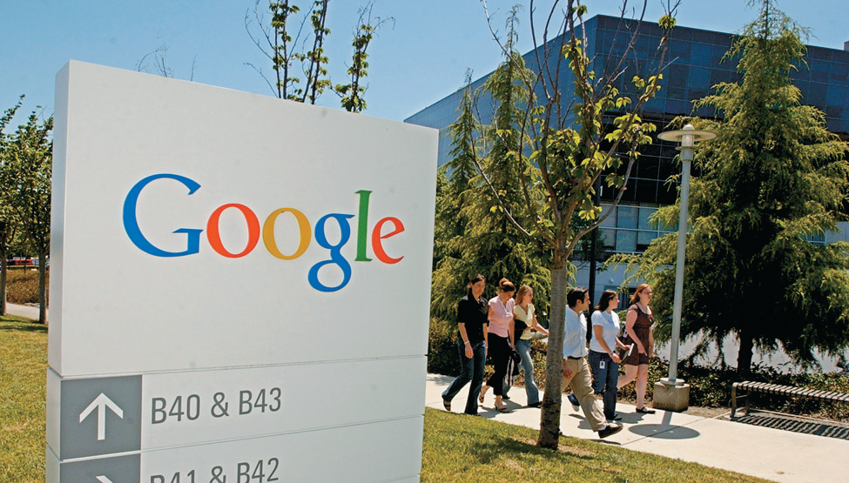
Is Google a monopoly?
Although there are many other
firms that offer search engines,
Google has a dominant
market share: 70% in the U.S.,
and 90% in Europe.
In the strictest sense, Google
is not a monopoly in the
search-engine market. But its
dominant market position provides it with many advantages, like the ability to exclude competitors from its content.
Of course, Google argues that its superiority is what has caused the high market share.
Modern governments realize that monopolies are generally “bad for consumers”, and discourage their existence.

Slide 7
Where Do Monopolies Come From?
15.2
Explain the four main reasons monopolies arise.

Slide 8
Reasons why monopolies exist
For a firm to exist as a monopoly, there must be barriers to entry preventing other firms coming in and competing with it.
The four main reasons for these barriers to entry are:
Government restrictions on entry
Exclusive control over a key resource
Network externalities
Natural monopoly
The next few slides will examine these in detail.

Slide 9
1. Government restrictions on entry
In the U.S., governments block entry in two main ways:
Patents and copyrights
Newly developed products like drugs are frequently granted patents, the exclusive right to produce a product for a period of 20 years from the date the patent is filed with the government.
Similarly, copyrights provide the exclusive right to produce and sell creative works like books and films.
Patents and copyrights encourage innovation and creativity, since without them, firms would not be able to substantially profit from their endeavors.
Public franchises
A government designation that a firm is the only legal provider of a good or service is known as a public franchise. These might exist, for example, in electricity or water markets.

Slide 10
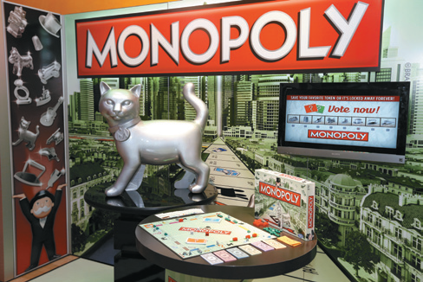
Does Hasbro have a monopoly on Monopoly?
Hasbro is the multinational American company that owns Monopoly.
Hasbro acquired Parker Brothers, which trademarked the name Monopoly for a board game in 1935.
Unlike patents and copyrights, trademarks never expire.
Without the trademark, other firms could market similar games with the same title, diluting Hasbro’s profits.
For example, in the 1970s a Californian economics professor started selling a game called Anti-Monopoly. Hasbro sued the professor; eventually the two parties reached an agreement where he could license the name Monopoly from Hasbro.

Slide 11
2. Exclusive control over a key resource
For many years, the Aluminum Company of America (Alcoa) either owned or had long-term contracts for almost all the world’s supply of bauxite, the mineral from which we obtain aluminum.
Such control over a key resource served as a substantial barrier to entry for additional firms.
The National Football League (NFL) acts as a monopoly in this manner too: it ensures that the majority of the world’s best football players are under contract to the NFL, and unable to be used for another potential league.

Slide 12
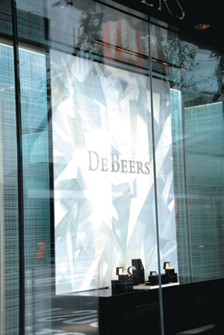
Are diamond profits forever?
The most famous monopoly based on control of a raw material is the De Beers diamond monopoly.
The South African De Beers firm sought to control as much of the supply of diamonds as possible, resulting in it being able to keep prices high.
But by 2000, new competitors had eroded De Beers’ control of the world’s diamond production to 40%.
Seeking to maintain its monopoly power, De Beers has started branding its diamonds with a “Forevermark”, supposedly indicating high quality. Do you think this marketing strategy will be successful long-term?

Slide 13
3. Network externalities
Economists refer to network externalities as a situation in which the usefulness of a product increases with the number of consumers who use it.
Examples: HD televisions
Computer operating systems (like Windows)
Social networking sites (like Facebook)
These network externalities can set off a virtuous cycle for a firm, allowing the value of its product to continue to increase, along with the price it can charge.
But consumers may be locked into an inferior product.

Slide 14
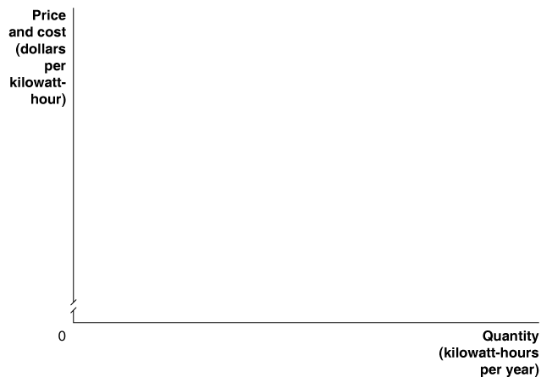
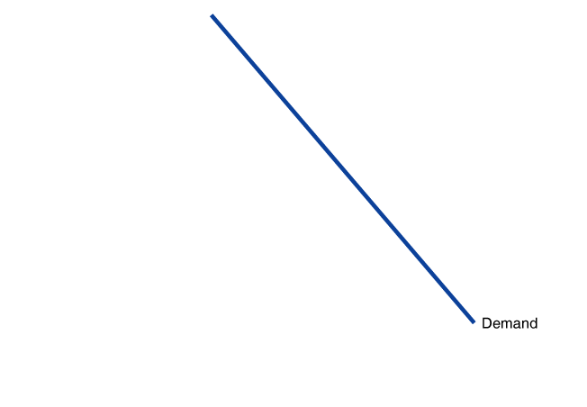
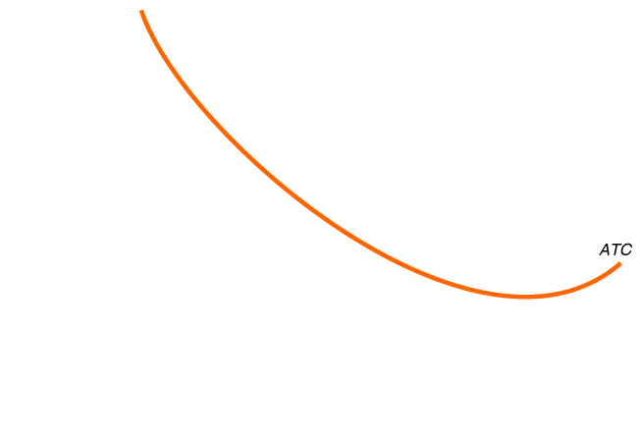
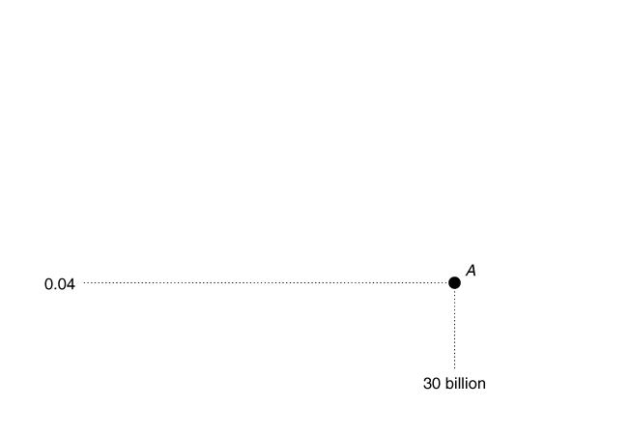
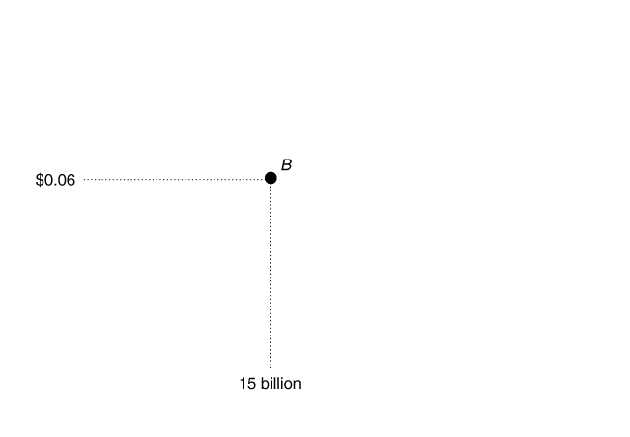
4. Natural monopoly
A natural monopoly occurs when economies of scale are so large that one firm can supply the entire market at a lower average total cost than can two or more firms.
In the market for electricity delivery, a single firm (point A) can deliver electricity at a lower cost than can two firms (point B).
Figure 15.1
Average total cost curve for a natural monopoly
This is often because of high fixed costs; in this example, the cost of erecting power lines and transformers, for example.
Notes:
With a natural monopoly, the average total
cost curve is still falling when it crosses the
demand curve (point A). If only one firm is
producing electric power in the market, and
it produces where the average cost curve
intersects the demand curve, average total
cost will equal $0.04 per kilowatt-hour of
electricity produced. If the market is divided
between two firms, each producing
15 billion kilowatt-hours, the average cost
of producing electricity rises to $0.06 per
kilowatt-hour (point B). In this case, if one
firm expands production, it can move down
the average total cost curve, lower its price,
and drive the other firm out of business.

Slide 15
How Does a Monopoly Choose Price and Output?
15.3
Explain how a monopoly chooses price and output.

Slide 16
The return of marginal cost and marginal benefit
In our study of oligopoly, we abandoned the idea of marginal cost and marginal revenue, because the strategic interaction between firms overrode these concepts.
Monopolists have no competitors, and hence no concern about strategic interactions.
They seek to maximize profit by choosing a quantity to produce, just like perfect and monopolistic competitors.
In fact, monopolists act very much like monopolistic competitors: they face a downward sloping demand curve.
The difference is that barriers to entry will prevent other firms from competing away their economic profit.

Slide 17
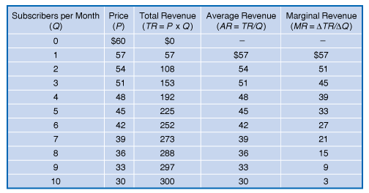
Calculating a monopoly’s revenue
Time Warner Cable is a monopolist in the market for cable television services.
The first two columns of the table show the market demand curve, which is also Time Warner’s demand curve.
Total, average, and marginal revenue are all calculated in the usual manner.
Figure 15.2a
Calculating a monopoly’s revenue (table)
Notes:
Time Warner Cable faces a downward-sloping
demand curve for subscriptions to
basic cable. To sell more subscriptions, it
must cut the price. When this happens, it
gains revenue from selling more subscriptions
but loses revenue from selling at a
lower price the subscriptions that it could
have sold at a higher price. The firm’s marginal
revenue is the change in revenue from
selling another subscription. We can calculate
marginal revenue by subtracting the
revenue lost as a result of a price cut from
the revenue gained. The table shows that
Time Warner’s marginal revenue is less
than the price for every subscription sold
after the first subscription. Therefore, Time
Warner’s
marginal revenue curve will be
below
its demand curve.

Slide 18
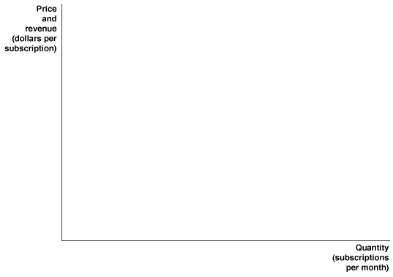
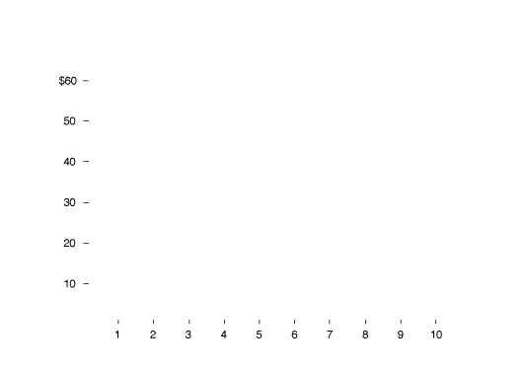
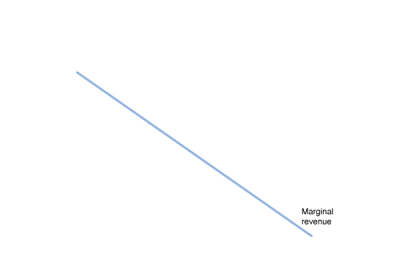
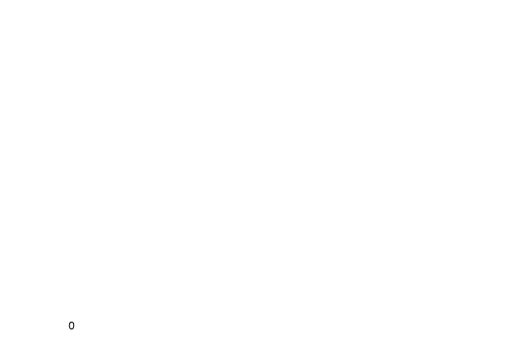
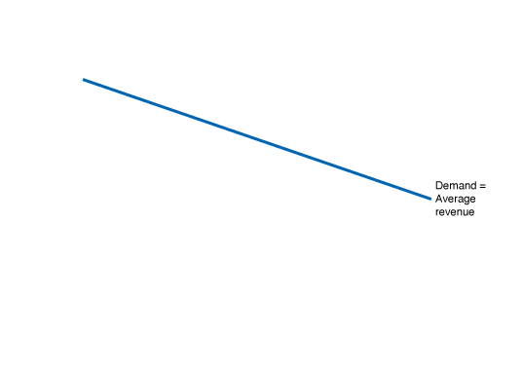
Calculating a monopoly’s revenue—continued
As the monopolist seeks to expand its output, two effects occur:
Revenue increases from selling an additional unit of output at whatever price is necessary to convince an additional customer to purchase it.
Revenue decreases, because the price reduction is shared with existing customers.
So marginal revenue is always below demand for a monopolist.
Figure 15.2b
Calculating a monopoly’s revenue (graph)

Slide 19
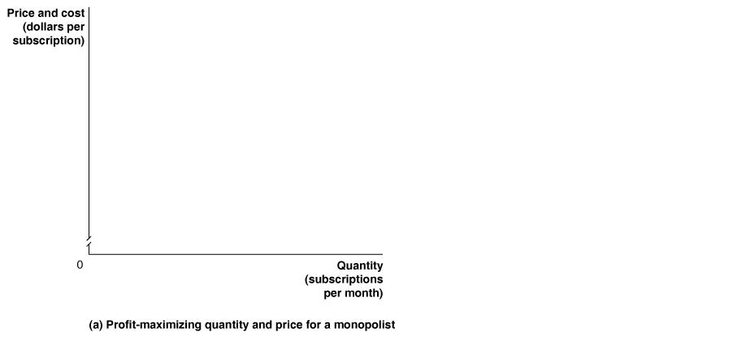
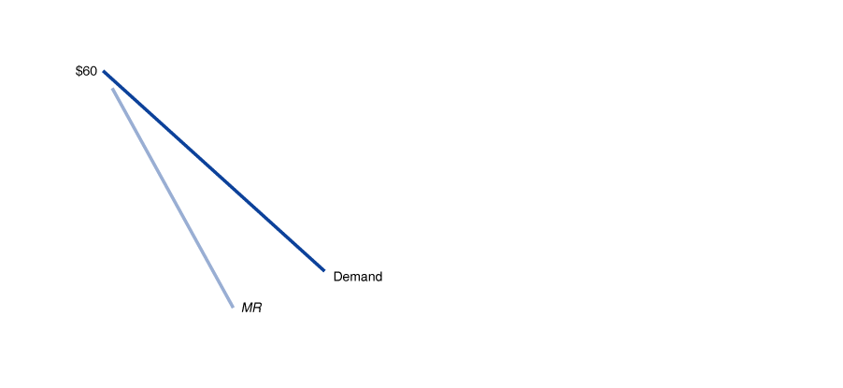
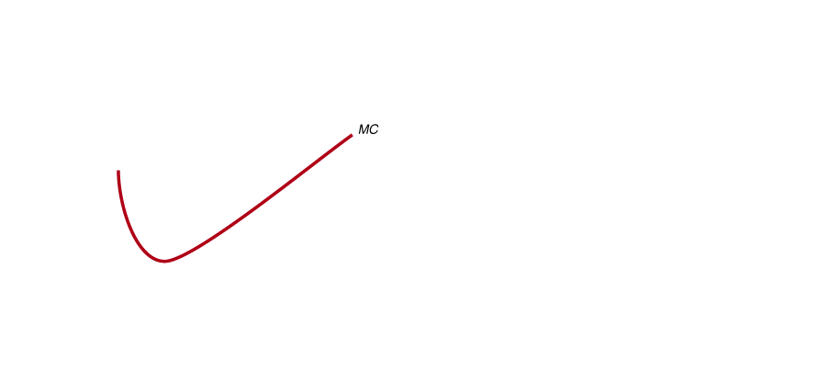
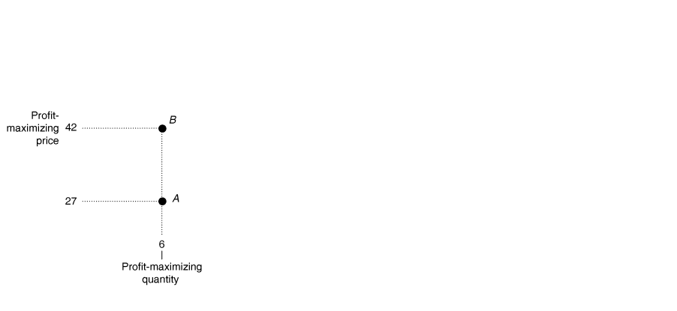
Proft-maximizing price and output for a monopoly
Figure 15.3a
Profit-maximizing price and output for a monopoly
The monopolist maximizes profit by producing the quantity where the additional revenue from the last unit (marginal revenue) just equals the additional cost incurred from its production (marginal cost).
MC = MR determines quantity for a monopolist.
Notes:
Panel (a) shows that to maximize profit, Time Warner should sell subscriptions up
to the point where the marginal revenue from selling the last subscription equals
its marginal cost (point A). In this case, both the marginal revenue from selling
the sixth subscription and the marginal cost are $27. Time Warner maximizes
profit by selling 6 subscriptions per month and charging a price of $42 (point B).
In panel (b), the green rectangle represents Time Warner’s profit. The rectangle
has a height equal to $12, which is the price of $42 minus the average total cost of
$30, and a base equal to the quantity of 6 cable subscriptions. Time Warner’s profit
therefore equals +12 * 6 = +72.

Slide 20
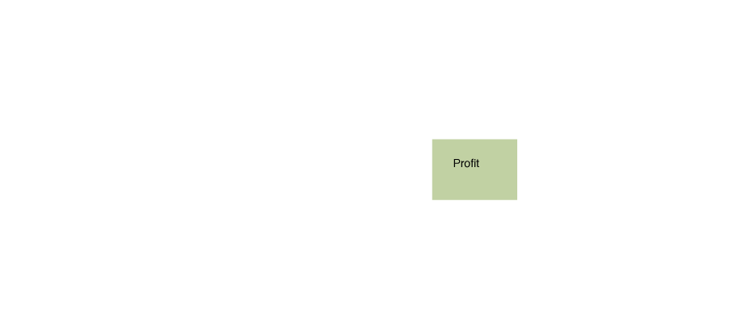
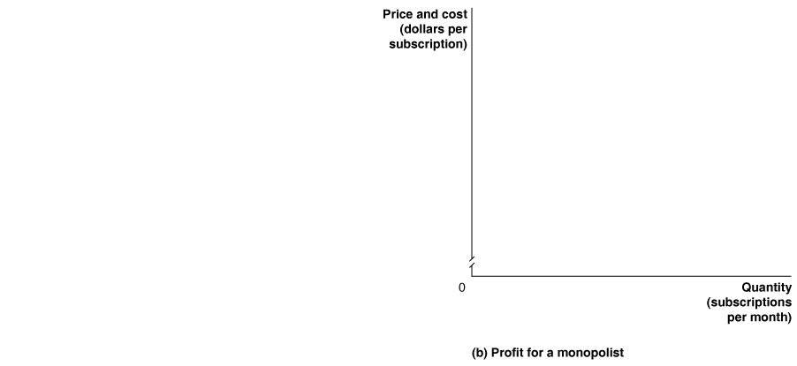
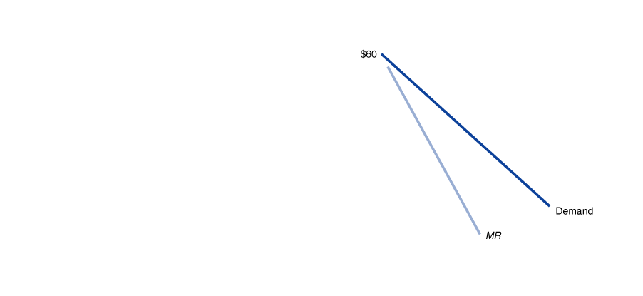
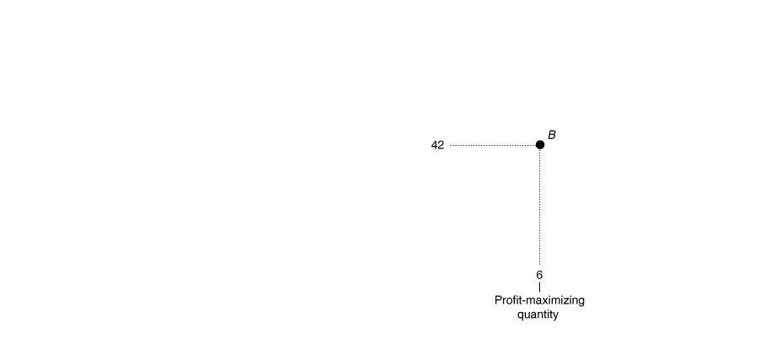
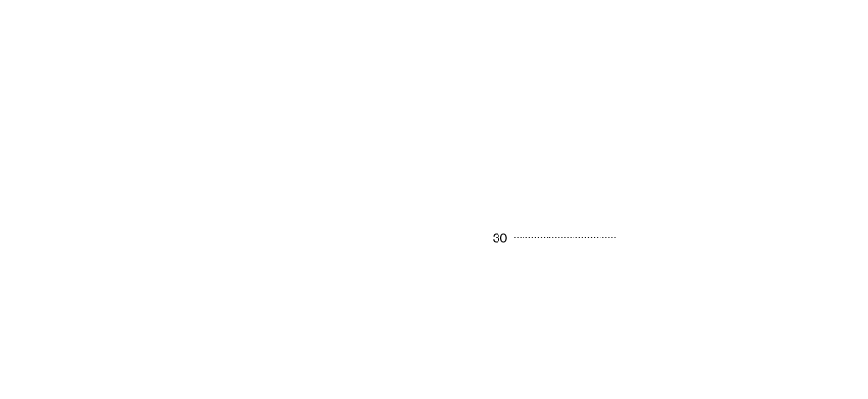
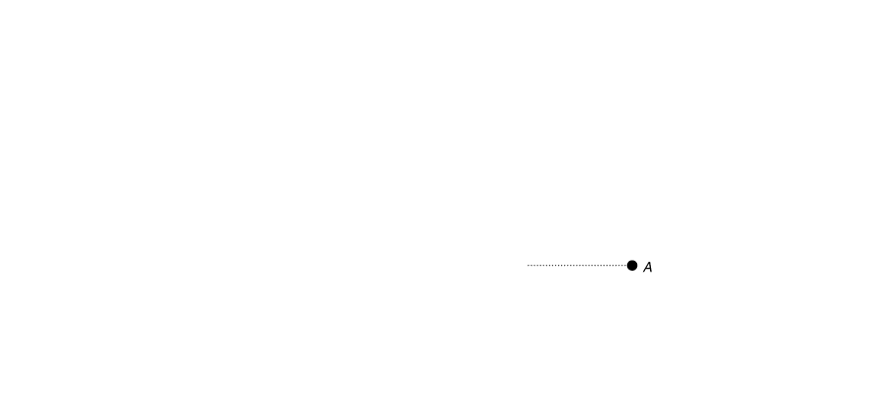
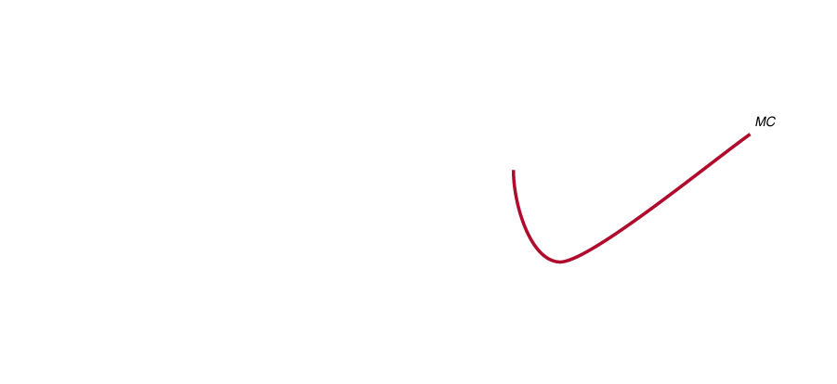
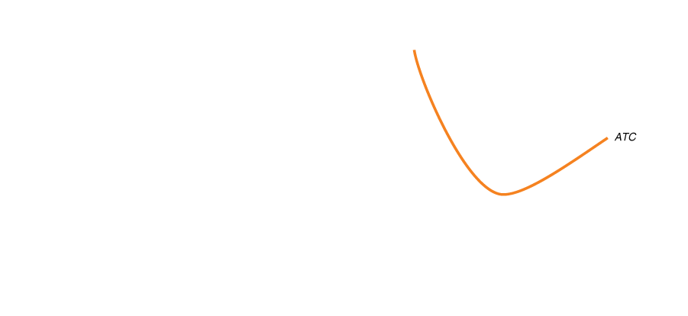
Price and output for a monopoly—continued
Figure 15.3a&b
Profit-maximizing price and output for a monopoly
At this quantity,
The demand curve determines price, and
The average total cost (ATC) curve determines average cost.
Profit is the difference between these (P–ATC), times quantity (Q).

Slide 21
Long-run profits for a monopoly
Since there are barriers to entry, additional firms cannot enter the market.
So there is no distinction between the short run and long run for a monopoly.
Then unlike for monopolistic competition, we expect monopolists to continue to earn profits in the long run.

Slide 22
Does Monopoly Reduce Economic Efficiency?
15.4
Use a graph to illustrate how a monopoly affects economic efficiency.

Slide 23
Comparing monopoly and perfect competition
Suppose that a market could be characterized by either perfect competition or monopoly. Which would be better?
The thought experiment here is to suppose there is some market that is perfectly competitive, say the market for smartphones.
Then a single firm buys up all of the smartphones in the country.
What would happen to:
Price of smartphones?
Quantity of smartphones traded?
The net benefit of consumers (i.e. consumer surplus)?
The net benefit of producers (i.e. producer surplus)?
The net benefit of all of society (i.e. economic surplus)?

Slide 24
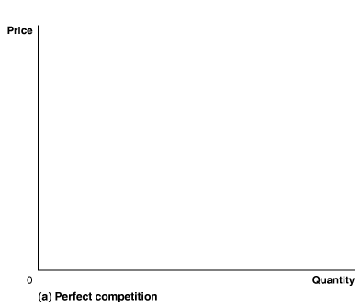
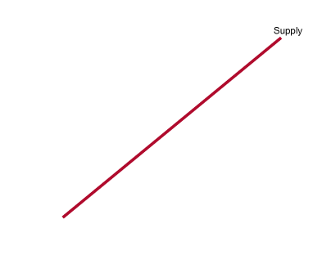
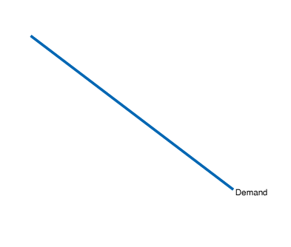
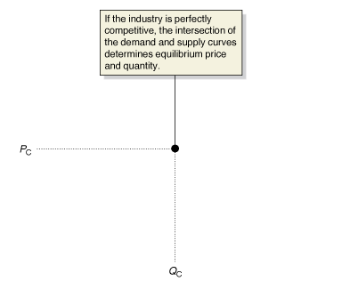
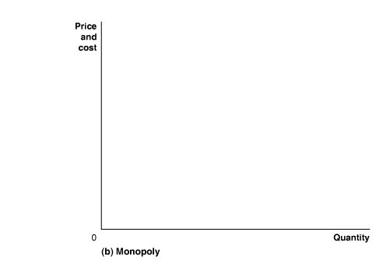
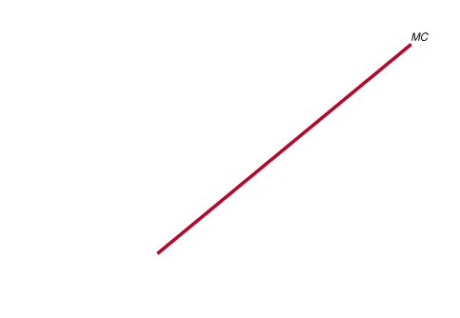
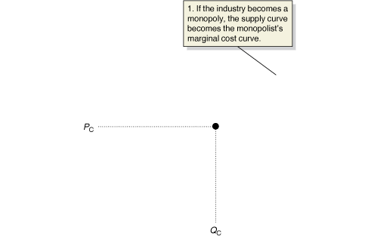
If a perfect competition became a monopoly…
Figure 15.4
What happens if a perfectly competitive industry becomes a monopoly?
The market for smartphones is initially perfectly competitive.
Price is P_{C}, quantity traded is Q_{C}.
Now the market is supplied by a single firm. Since the single firm is made up of all of the smaller firms, the marginal cost curve for this new firm is identical to the old supply curve.
Notes:
In panel (a), the market for smartphones is perfectly competitive, and price and
quantity are determined by the intersection of the demand and supply curves. In
panel (b), the perfectly competitive smartphone market becomes a monopoly.
As a result:
1. The industry supply curve becomes the monopolist’s marginal cost curve.
2. The monopolist reduces output to where marginal revenue equals marginal cost, QM.
3. The monopolist raises the price from PC to PM.

Slide 25
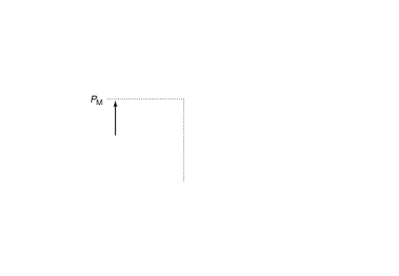
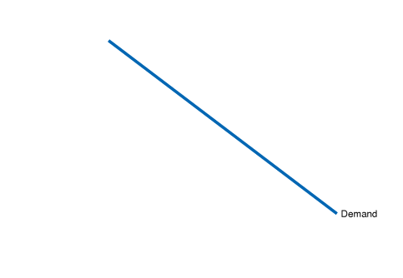
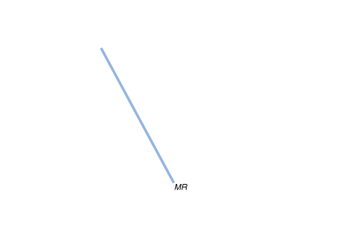
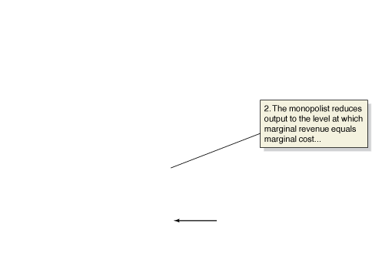
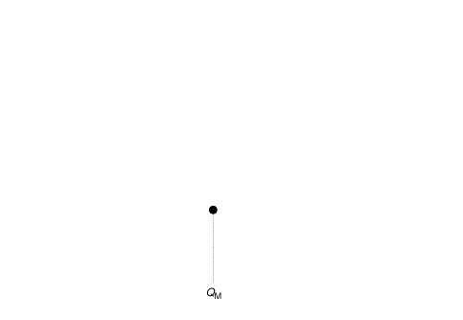
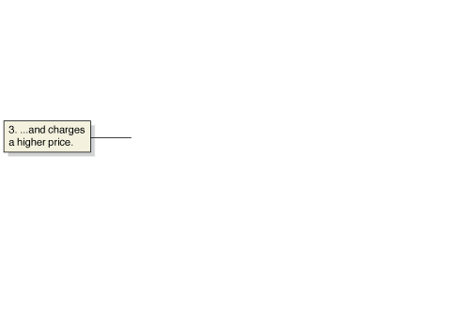
… quantity will fall and price will rise
Figure 15.4
What happens if a perfectly competitive industry becomes a monopoly?
But the new firm maximizes market profit, producing the quantity where marginal cost equals marginal revenue (MC = MR).
This quantity (Q_{M}) is lower than the competitive quantity (Q_{C})…
… and the firm charges the corresponding price on the demand curve, P_{M}. This price is higher than the competitive price, P_{C}.

Slide 26
Measuring the efficiency loss from monopoly
Fewer smartphones will be traded at a higher price.
Consumer surplus will fall (with the higher price).
Producer surplus must rise, otherwise the firm would have chosen the perfectly competitive price and quantity.
Could the increase in producer surplus offset the decrease in consumer surplus?
No! Perfectly competitive markets maximized the economic (total) surplus in a market; if fewer trades take place, the economic surplus must fall.

Slide 27
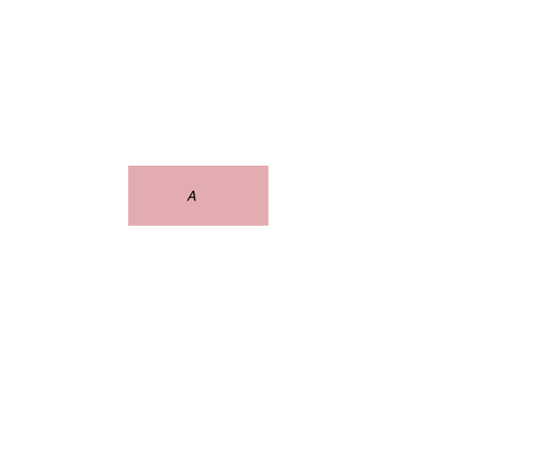
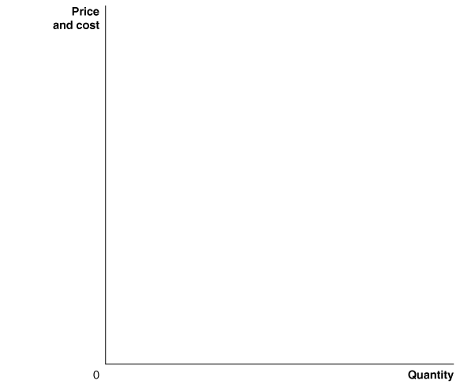
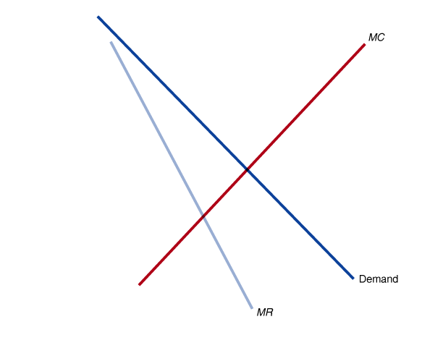
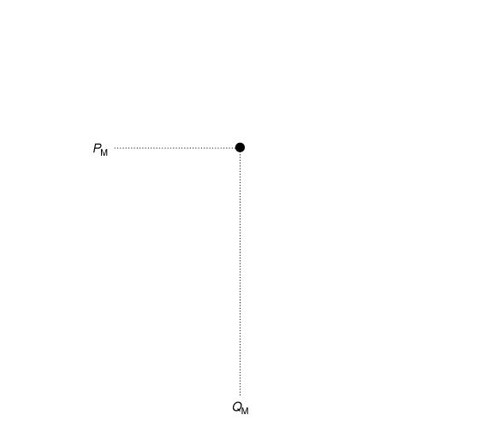
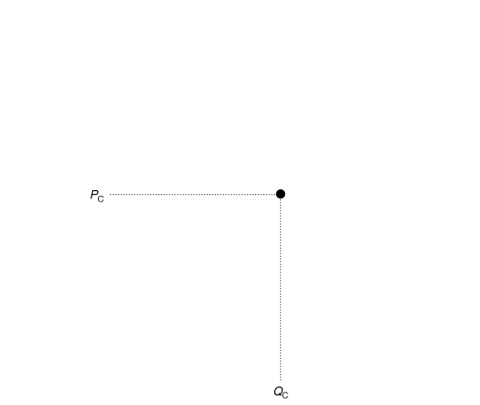
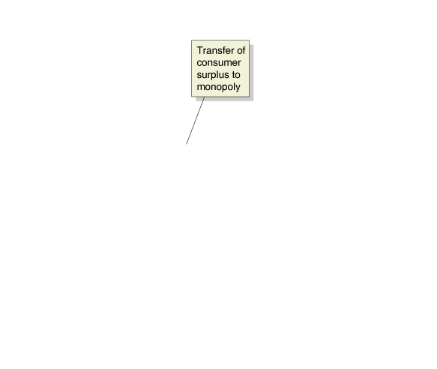
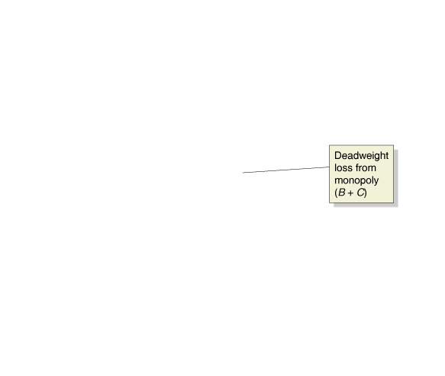
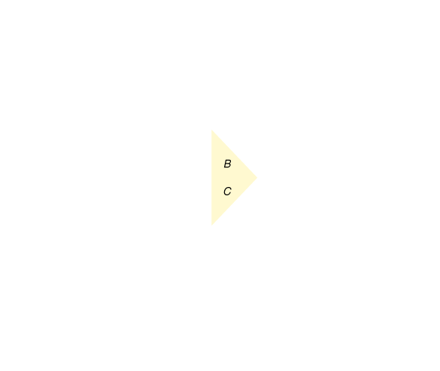
The inefficiency of monopoly
With the higher monopoly price, consumer surplus decreases by the areas A+B.
Producer surplus falls by C, but rises by A; an overall increase.
Area A simply is simply a transfer of surplus: neither inherently good nor bad.
But areas B and C are lost surpluses: deadweight loss.
Figure 15.5
The inefficiency of monopoly
Notes:
A monopoly charges a higher price, PM, and
produces a smaller quantity, QM, than a perfectly
competitive industry, which charges
price PC and produces QC. The higher price
reduces consumer surplus by the area equal
to the rectangle A and the triangle B. Some
of the reduction in consumer surplus is captured
by the monopoly as producer surplus,
and some becomes deadweight loss, which
is the area equal to triangles B and C.

Slide 28
How large are the efficiency losses?
There are relatively few monopolies, so the loss of economic efficiency due to monopolies must be relatively small.
But many firms have market power: the ability of a firm to charge a price greater than marginal cost.
In fact, the only firms that do not have market power are perfectly competitive firms; and perfect competition is rare.
Economists estimate that overall, the loss of efficiency in the United States due to market power is probably less than 1% of total U.S. production—about $500 per person annually.
Why so low? Most firms face a relatively large degree of competition, resulting in prices much closer to marginal cost than we would see with monopolies.
So deadweight loss due to market power is relatively small.

Slide 29
An argument in favor of market power
Market power may produce some benefit for an economy: the prospect of market power (and the resulting economic profits) drives firms to innovate, creating new products and services.
This drive affects large firms—who reinvest profits in the hope of making larger future profits—and small firms—who hope to obtain profits for themselves—alike.
The Austrian economist Joseph Schumpeter claimed that this drive would create a “gale of creative destruction” that would eventually benefit consumers more than increased price competition.
This helps to explain governmental ambivalence regarding large firms with market power.

Slide 30
Government Policy toward Monopoly
15.5
Discuss government policies toward monopoly.

Slide 31
Antitrust laws and antitrust enforcement
In the 1870s and 1880s, several “trusts” had formed: boards of trustees that oversaw the operation of several firms in an industry, and enforced collusive agreements.
This helped prompt U.S. antitrust laws, aimed at eliminating collusion and promoting competition among firms. The most important of these laws are detailed here.
Law | Date Enacted | Purpose
Sherman Act | 1890 | Prohibited “restraint of trade,” including price fixing and collusion. Also outlawed monopolization.
Clayton Act | 1914 | Prohibited firms from buying stock in competitors and from having directors serve on the boards of competing firms.
Federal Trade Commission Act | 1914 | Established the Federal Trade Commission (FTC) to help administer antitrust laws.
Robinson-Patman Act | 1936 | Prohibited firms from charging buyers different prices if the result would reduce competition.
Cellar-Kefauver Act | 1950 | Toughened restrictions on mergers by prohibiting any mergers that would reduce competition.
Table 15.1
Important U.S. antitrust laws

Slide 32

Did Apple’s e-Book pricing violate the law?
When Apple introduced the iPad in 2010, the prices of new e-books and bestsellers increased from $9.99 to $12.99 or $14.99.
The Justice Department claimed that Apple had organized an agreement with five large book publishers to raise the price of e-books: “an old-fashioned, straight-forward price-fixing agreement.”
At trial, Apple defended its pricing by claiming it was using an agency-pricing model similar to their iTunes store: allowing publishers to set the price, and keeping 30% of the sales revenue.
In the end, the judge sided with the DOJ: Apple did indeed conspire with publishers to raise e-book prices.

Slide 33
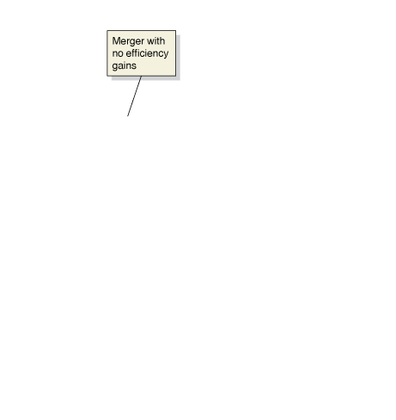
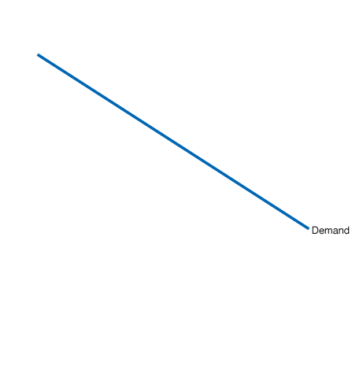
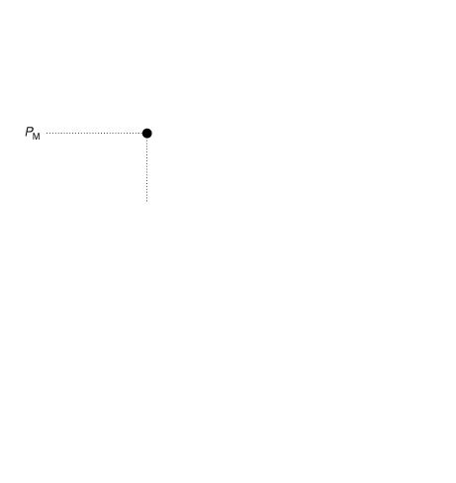





Mergers without efficiency gains
The Federal government is particularly concerned about horizontal mergers: mergers between firms in the same industry, as opposed to vertical mergers between two firms at different stages of the production process.
Such mergers are likely enhance firms’ market power.
The graph shows such a merger, increasing the price from the competitive price (P_{C}) to the monopoly price (P_{M}), and resulting in deadweight loss.
Figure 15.6
A merger that makes consumers better off
Notes:
This figure shows the result of all the firms
in a perfectly competitive industry merging
to form a monopoly. If the merger does
not affect costs, the result is the same as in
Figure
15.5 on page 491: Price rises from PC
to PM, quantity falls from QC to QM, consumer
surplus declines, and a loss of economic efficiency
results. If, however, the monopoly
has lower costs than the perfectly competitive
firms, as shown by the marginal cost curve
shifting to MC after the merger, it is possible
that the price of the good will actually decline
from PC to PMerge and that output will increase
from QC to QMerge following the merger.

Slide 34





Mergers with efficiency gains
Firms seeking to merge typically argue that the resulting larger firm will have lower costs, and hence be able to produce more efficiently.
Then even if they charge the (new) monopoly price, the result is an improvement for consumers.
However, costs may not decrease by as much as the firms claim, resulting in consumers being worse off.
Economists with the FTC and Department of Justice review potential mergers one-by-one.
Figure 15.6
A merger that makes consumers better off

Slide 35
DOJ and FTC merger guidelines
Economists and lawyers at the Department of Justice and the Federal Trade Commission developed guidelines for themselves and firms to use in evaluating whether potential merger was acceptable.
These include:
Market definition
Measure of concentration
Merger standards

Slide 36
1. Market definition
Suppose Hershey Foods sought to merge with Mars Inc.
In what market do these firms compete? The market for candy? The market for snacks? The market for all food?
The more broadly defined the market, the smaller (and more harmless) the merger appears.
To determine the appropriate scope of the market, the government tries to determine which goods are close substitutes for those produced by the firms.
The “appropriate market” is defined as the smallest market containing the firms’ products for which an overall price rise within the market would result in total market profits increasing.
(If profits would decrease, there must be adequate substitutes available; hence the market is too narrowly defined.)

Slide 37
2. Measure of concentration
A market is concentrated if a relatively small number of firms have a large share of total sales in the market.
To determine if a market is concentrated, the government uses the Herfindahl-Hirschman Index (HHI), created by squaring the percentage market shares of each firm, and adding up the results.
Some examples are given below:
Firm market shares | Formula | HHI
100% | 100² | 10,000
50%, 50% | 50² + 50² | 5,000
30%, 30%, 20%, 20% | 30² + 30² + 20² + 20² | 2,600
10%, 10%, …, 10% | 10 x 10² | 1,000

Slide 38
3. Merger standards
Based on the calculated HHI values, the DOJ and FTC apply the following standards to determine if they ought to challenge the potential merger of two or more firms:
 | Increase in HHI
Post-merger HHI | < 100 | 100 – 200 | > 200
< 1,500 | Challenge unlikely | Challenge unlikely | Challenge unlikely
1,500 – 2,500 | Challenge unlikely | Challenge possible | Challenge possible
> 2,500 | Challenge unlikely | Challenge possible | Challenge very likely
Firms having their merger applications challenged must satisfy the DOJ and FTC that their merger would result in substantial efficiency gains. The burden of proof is on the merging firms.

Slide 39
Regulating natural monopolies
Natural monopolies have the potential to serve customers more cheaply than multiple firms. But the usual market forces that drive price down do not exist.
Local and/or state regulatory commissions typically set prices for these natural monopolies, instead of allowing the firms to set their own price.
But that raises the question: what price should the regulators choose?
A price that makes the monopoly make zero profit?
The efficient price that would maximize consumer welfare?

Slide 40









Regulating a natural monopoly
If the natural monopoly were not subject to regulation, it would choose quantity Q_{M} and price P_{M}.
Efficiency (MC = MR) suggests a price of Q_{E}. But then the firm makes a loss.
Figure 15.7
Regulating a natural monopoly
The typical compromise is to allow the firm to charge a price where it can make zero economic profit: P_{R}. The resulting quantity Q_{R} is hopefully close to the efficient level, keeping deadweight loss small.
Notes:
A natural monopoly that is not subject to
government regulation will charge a price
equal to PM and produce QM. If government
regulators want to achieve economic efficiency,
they will set the regulated price equal
to PE, and the monopoly will produce QE.
Unfortunately, PE is below average total cost,
and the monopoly will suffer a loss, shown
by the red rectangle. Because the monopoly
will not continue to produce in the long run
if it suffers a loss, government regulators set
a price equal to average total cost, which is
PR in the figure. The resulting production,
QR, will be below the efficient level.

Slide 41
Common misconceptions to avoid
Monopoly is a market structure; natural monopoly is a reason the monopoly market structure might exist. Monopolies need not be natural monopolies.
No monopolist, not even a natural monopolist, tries to minimize cost. MC = MR guides an (unregulated) monopolist.
While our graphs tend to show the efficiency loss from monopolies to be high, estimates of the efficiency loss due to all market power are really quite low: <1% of total output.
Monopolists cannot just charge any price they want; they are always subject to the market demand curve.

